Slide 1
Best Practices
Building and Designing Data Visualizations
#mstrworld

Slide 2
Agenda
•
•
•
•
•
•
•
•
•
The Need for Data Visualization
Types and Functions of Data Visualization
The Data You Have
Getting to Know the Visualizations
Color and Formatting
Shapes and Labels
Building a Dashboard
Next Steps
Questions and
Answers
2 #mstrworld

Slide 3
The Need for Data Visualization
Why do we visualize data?
“The purpose
visualization -
of data visualization
– any data
is to illuminate data. To show
patterns and relationships that are otherwise
hidden
in
an
impenetrable mass of numbers”
-Robert Simmon, OpenVis Conference 2014
3 #mstrworld

Slide 4
The Need for Data Visualization
Data Visualization makes hidden trends and patterns in the data easily visible
How
many
times
does
the number
89 appear?
78 42 71 43 84 27 83 91 39 18 80 15 44 66 79
32 15 68 40 35 54 93 47 22 77 87 85 35 17 62
99 47 44 19 39 12 78 87 99 75 21 75 65 43 66
41 56 22 66 62 29 96 21 41 55 48 7 25 85 9
91 67 53 33 34 28 28 24 6 33 94 68 81 24 89
67 70 18 97 40 46 29 0 36 28 17 44 83 17 31
0 96 95 39 60 81 24 56 27 4 36 22 38 9 12
83 6 94 92 47 70 94 50 18 67 80 13 56 25 96
65 78 41 89 42 33 53 37 10 35 82 40 71 18 34
58 79 58 33 99 59 33 68 4 34 19 78 11 23 1
46 8 43 89 91 57 3 45 7 87 22 1 7 79 97
21 92 34 39 4 47 8 84 30 19 38 46 48 70 77
22 68 58 23 59 18 94 49 47 30 5 22 60 73 93
64 15 20 46 79 47 43 55 52 48 31 46 25 49 38
55 16 29 91 93 61 86 87 4 83 87 91 58 7 30
27 43 8 91 12 48 74 41 45 30 17 83 20 66 11
#mstrworld

Slide 5
The Need for Data Visualization
Data Visualization makes hidden trends and patterns in the data easily visible
How
many
times
does
the number
89 appear?
78 42 71 43 84 27 83 91 39 18 80 15 44 66 79
32 15 68 40 35 54 93 47 22 77 87 85 35 17 62
99 47 44 19 39 12 78 87 99 75 21 75 65 43 66
41 56 22 66 62 29 96 21 41 55 48 7 25 85 9
91 67 53 33 34 28 28 24 6 33 94 68 81 24 89
67 70 18 97 40 46 29 0 36 28 17 44 83 17 31
0 96 95 39 60 81 24 56 27 4 36 22 38 9 12
83 6 94 92 47 70 94 50 18 67 80 13 56 25 96
65 78 41 89 42 33 53 37 10 35 82 40 71 18 34
58 79 58 33 99 59 33 68 4 34 19 78 11 23 1
46 8 43 89 91 57 3 45 7 87 22 1 7 79 97
21 92 34 39 4 47 8 84 30 19 38 46 48 70 77
22 68 58 23 59 18 94 49 47 30 5 22 60 73 93
64 15 20 46 79 47 43 55 52 48 31 46 25 49 38
55 16 29 91 93 61 86 87 4 83 87 91 58 7 30
27 43 8 91 12 48 74 41 45 30 17 83 20 66 11
#mstrworld

Slide 6
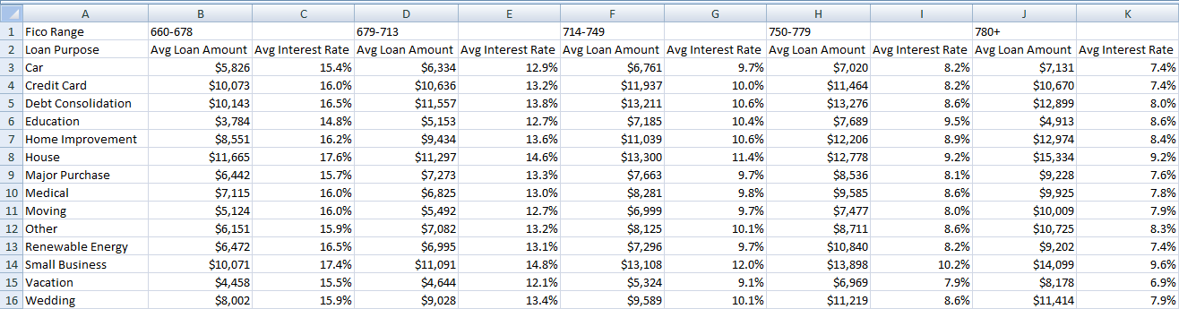
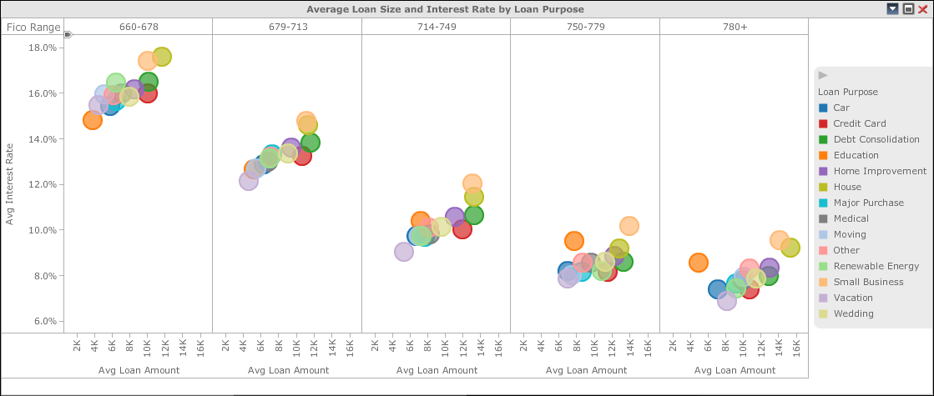
Why We Visualize
Good Visualizations Should Make Data Actionable

Slide 7
Agenda
•
•
•
•
•
•
•
•
•
The Need for Data Visualization
Types and Functions of Data Visualization
The Data You Have
Getting to Know the Visualizations
Color and Formatting
Shapes and Labels
Building a Dashboard
Next Steps
Questions and
Answers

Slide 8
Types and Functions of Data Visualization
Tables vs. Graphs
•
•
Tables – Interact primarily with verbal system.
Graphs – Interact primarily with
visual
system.
3
Factors
to
consider:
Audience
• Who is your audience?
• What are they
expecting?
• How will they interact
with the data?
Data
• How much data do you
have?
• What kind of data?
Goals
• What is the purpose of
your visualization?
• What kind of insight
are sharing?

Slide 9
Types and Functions of Data Visualization
What is the purpose of your visualization?
Interactive
Exploratory
Explanatory
Static
9 #mstrworld

Slide 10
Agenda
•
•
•
•
•
•
•
•
•
The Need for Data Visualization
Types and Functions of Data Visualization
The Data You Have
Getting to Know the Visualizations
Color and Formatting
Shapes and Labels
Building a Dashboard
Next Steps
Questions and
Answers
10 #mstrworld

Slide 11
Understand Your Data
Know your data to visualize it correctly
Data Types
Qualitative
(Attributes)
Nominal Data
• Defines, Describes or Identifies
Ordinal Data
• Indicates Position or Order
Quantitative (Metrics)
Cardinal Data
• Quantifies, Counts or Measures

Slide 12
Understand Your Data
Qualitative Data Types - Attributes
Ordinal Data
Data that can be counted and ordered, but not aggregated
Examples
• Date – 1/1/2015, 1/2/2015, 1/3/2015
• Rank – Like, Neutral, Dislike
• Grade – C, C+, B-, B, B+, A-, A, A+
12 #mstrworld

Slide 13
Understand Your Data
Qualitative Data Types - Attributes
Nominal Data
Data that be counted, but not ordered or aggregated.
Examples
• Product – Books, Movies, Magazines
• Gender – Male, Female
• City – Los Angeles, New York, Arlington
13 #mstrworld

Slide 14
Understand Your Data
Quantitative Data Types - Metrics
Cardinal Data
Data that can be counted, ordered, and aggregated.
Examples
• KPIs – Revenue, Cost, Profit
• Counts – Number of Employees, Number of Units
• Measures – Distance, Time, Temperature
14 #mstrworld

Slide 15
Agenda
•
•
•
•
•
•
•
•
•
The Need for Data Visualization
Types and Functions of Data Visualization
The Data You Have
Getting to Know the Visualizations
Color and Formatting
Shapes and Labels
Building a Dashboard
Next Steps
Questions and
Answers
15 #mstrworld

Slide 16
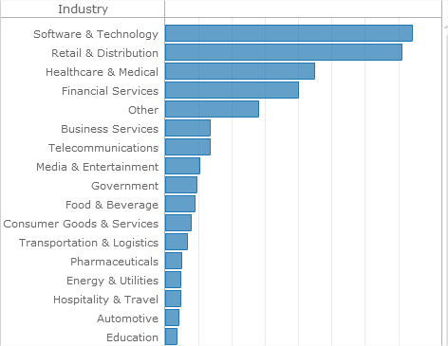
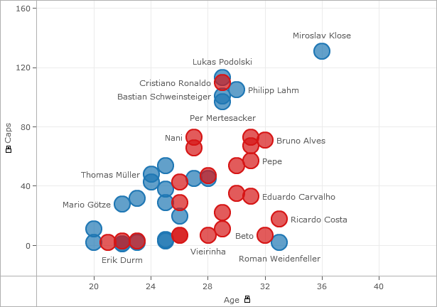
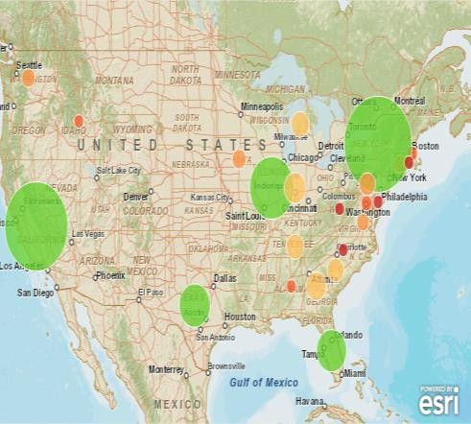
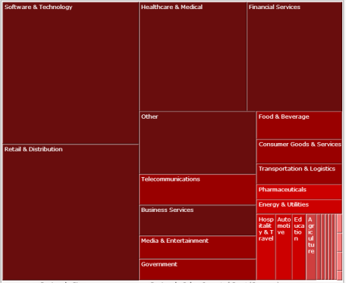
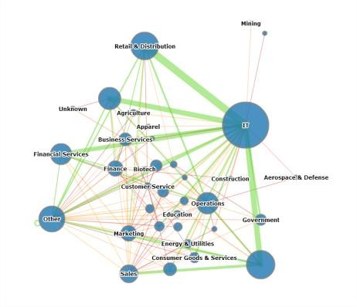
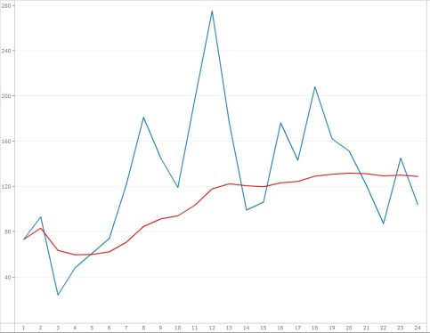
Getting to Know The
Visualizations
Selecting a Visualization
Comparisons
Distribution
Geospatial
Part-to-whole
Relationships
Time
16 #mstrworld

Slide 17
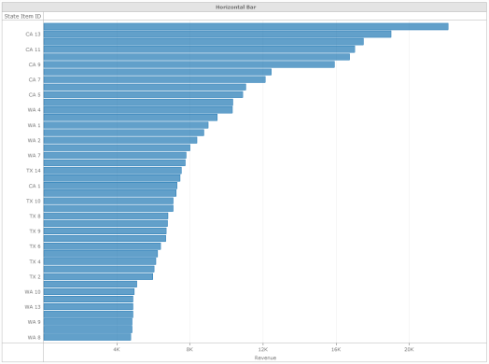
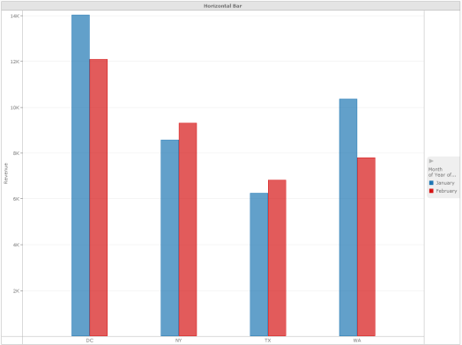
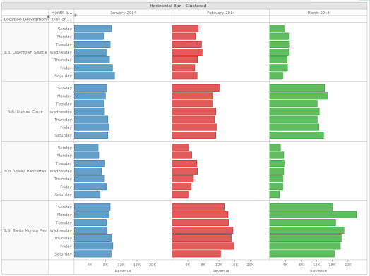
Getting to Know The Visualizations
Comparison Visualizations
Comparisons
Few Categories
Many Categories
Few Items
Many
Items
Clustered Bar Chart
Bar Chart
Bar Chart Matrix
17 #mstrworld

Slide 18
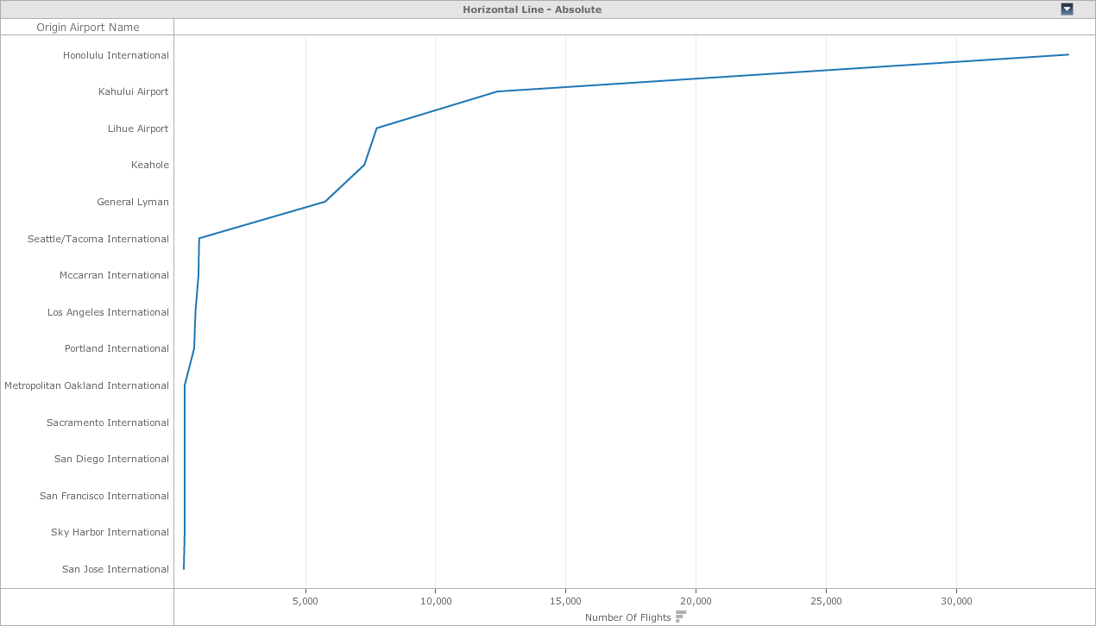
Getting to Know The Visualizations
Comparison Visualizations – To Avoid
Avoid
Using
Line Charts
Implies Continuity between points.
18 #mstrworld

Slide 19
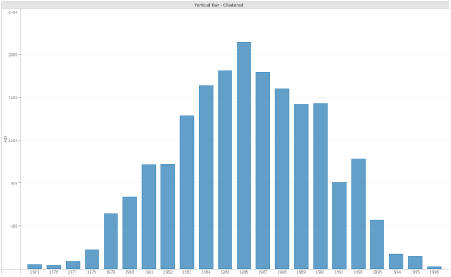
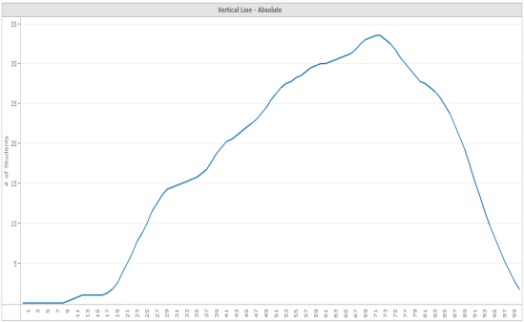
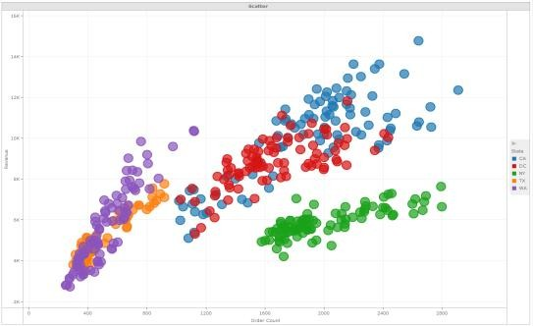
Getting to Know The Visualizations
Distribution Visualizations
Distribution
Single Variable
Two Variables
Few Items
Many Items
Column Histogram
Line Histogram
Scatter Plot
19 #mstrworld

Slide 20
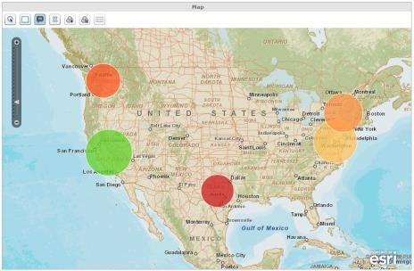
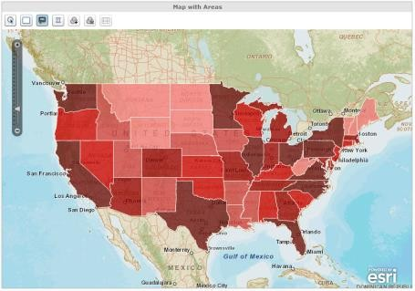
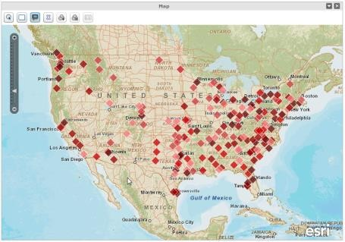
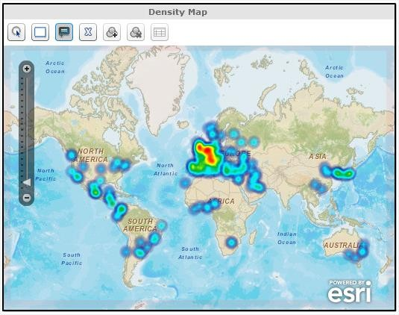
Getting to Know The
Visualizations
Geospatial Visualizations
Geography
Few Data Points
Many Data
Points
Bubble Map
Marker Map
Area Map
Density Map
20 #mstrworld

Slide 21
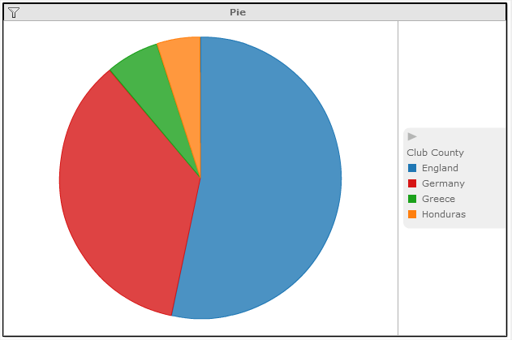
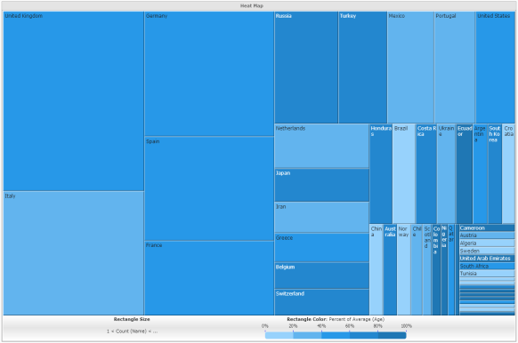
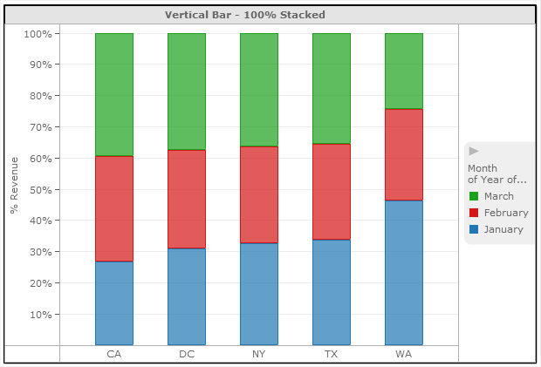
Getting to Know The
Visualizations
Part-to-whole Visualizations
Part-to-whole
Few Categories
Many Categories
Parts
of
Categories
Pie Chart
Heat Map
100% Stacked Bar
21 #mstrworld

Slide 22
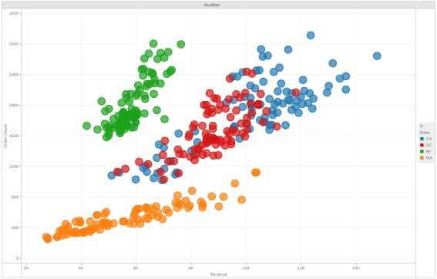
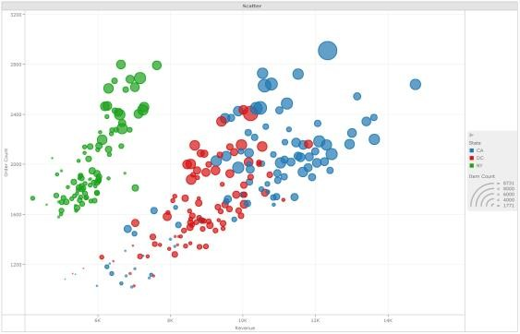
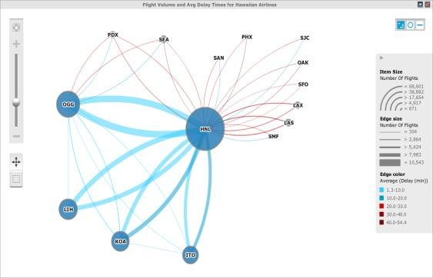
Getting to Know The
Visualizations
Relationship Visualizations
Relationship
Two Variables
Three
Variables
Related
Elements
Scatter Plot
Bubble Chart
Network Graph
22 #mstrworld

Slide 23
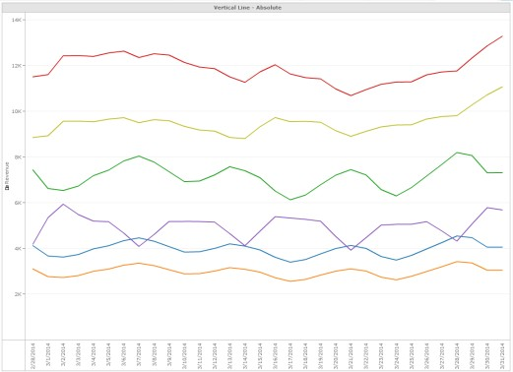
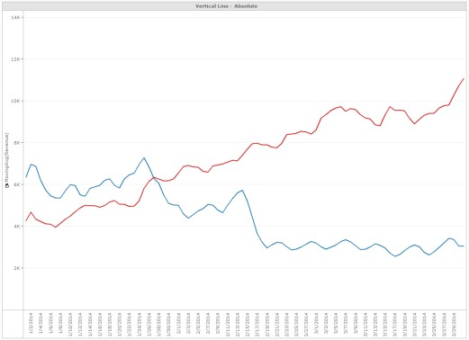
Getting to Know The Visualizations
Time Visualizations
Time
Few Periods
Many Periods
Single of
Few Categories
Many Categories
Clustered Bar Chart
Line Graph
Line Graph
23 #mstrworld

Slide 24
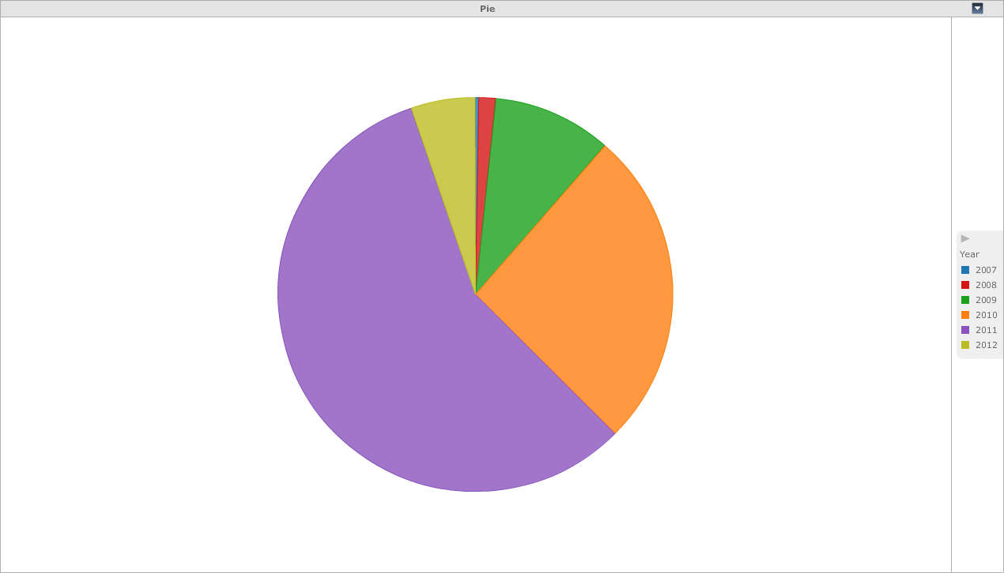
Getting to Know
The
Visualizations
Time Visualizations
Avoid
Using
Pie Chart
Removes Ordinality
24 #mstrworld

Slide 25
Agenda
•
•
•
•
•
•
•
•
•
The Need for Data Visualization
Types and Functions of Data Visualization
The Data You Have
Getting to Know the Visualizations
Color and Formatting
Shapes and Labels
Building a Dashboard
Next Steps
Questions and
Answers
25 #mstrworld

Slide 26

Color and Formatting
Using color and size to enhance your visualization
Formatting your visualization with colors and sizing can help you
communicate the insights
in
your
data
and
improve user experience.
Hue
Saturation
26 #mstrworld

Slide 27
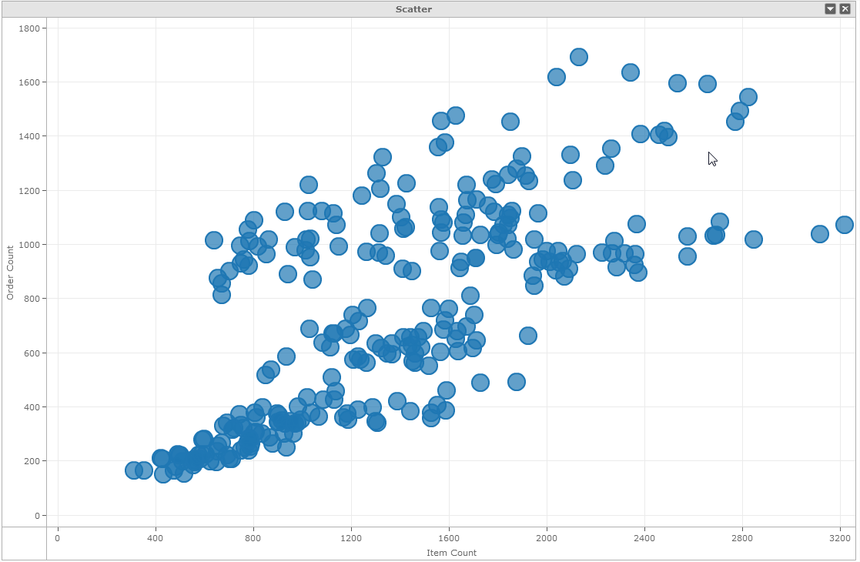
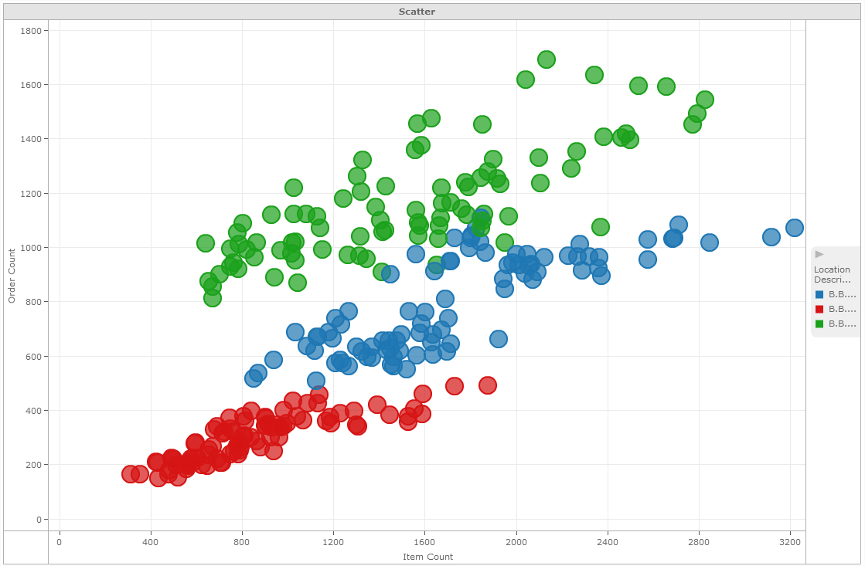
Color and Formatting
Hues - Using color bands
Hues can be used to create bands of contrasting colors. Apply the banding
on
attributes
to
visualize
trends
and
insights
for attribute
elements.
Use opposing colors to increase contrast between attributes
elements.
27 #mstrworld

Slide 28
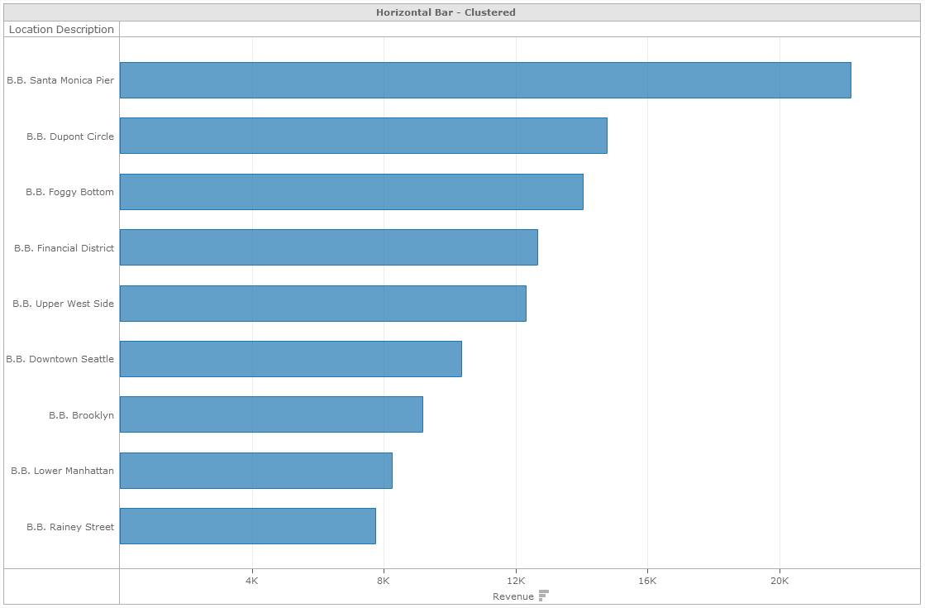
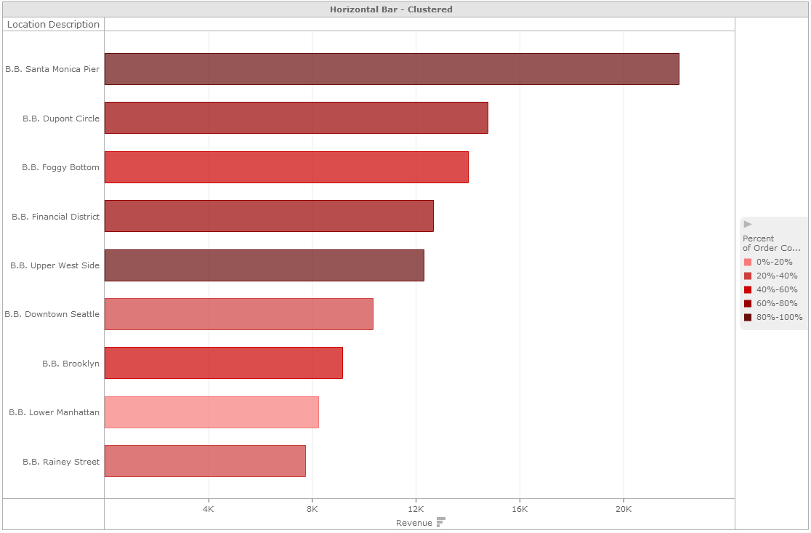
Color and Formatting
Saturation - Using color gradients
Saturation can be used to visualize additional quantitative data (metrics). Use
the metrics
to
color
visualization
elements
by an additional
measure.
Use less saturation
for lower values, and more saturation for higher values.
28 #mstrworld

Slide 29
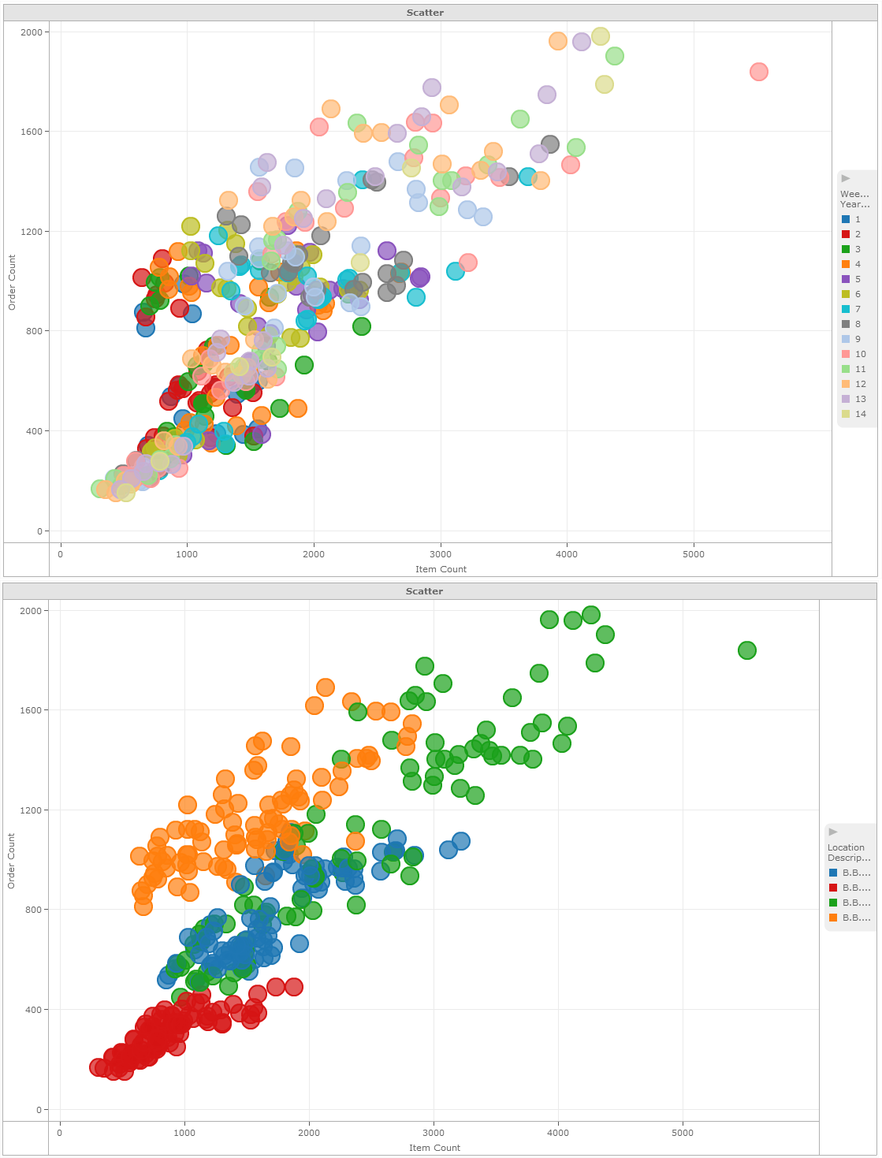
Color and Formatting
Using the right number of colors
Use
Fewer
Than
6
Colors
29 #mstrworld

Slide 30

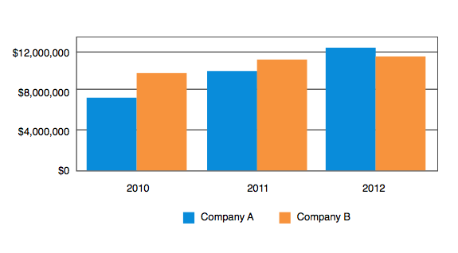
Color and Formatting
Using colors to emphasize and contrast
Use
Opposing
Colors
for
Comparisons
30 #mstrworld

Slide 31
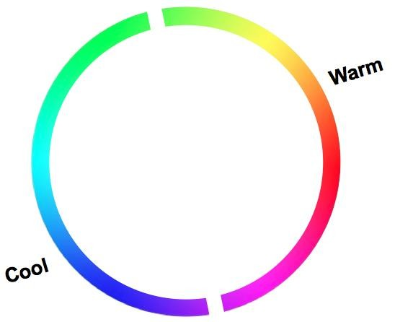
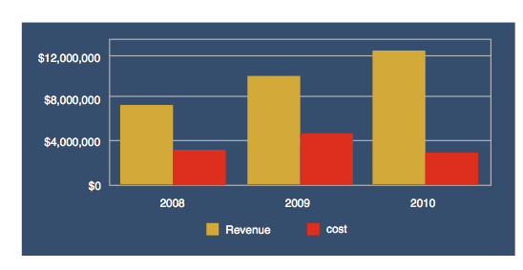
Color and Formatting
Using colors to emphasize and contrast
Use
Opposing
Cool
Colors
for
Backgrounds,
Warm
Colors
for
Data
31 #mstrworld

Slide 32
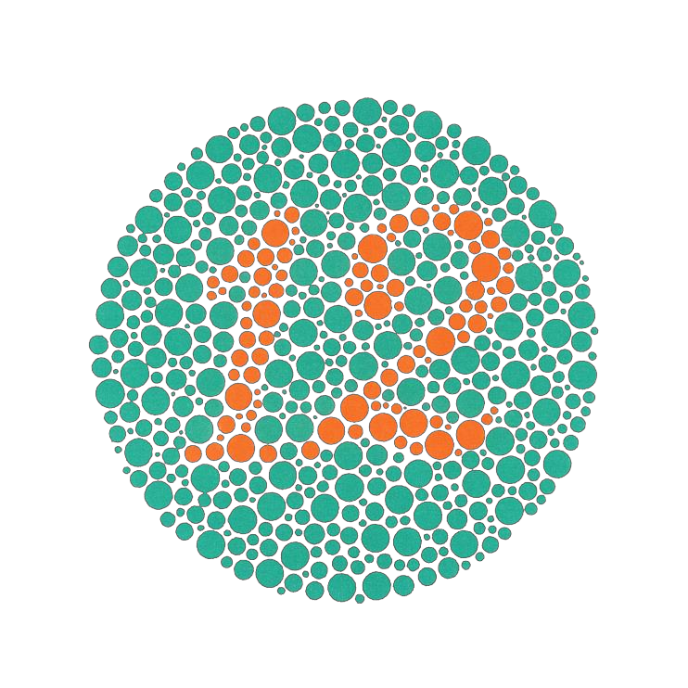
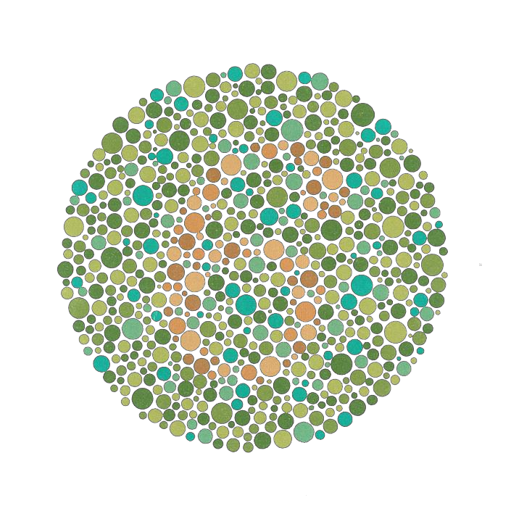
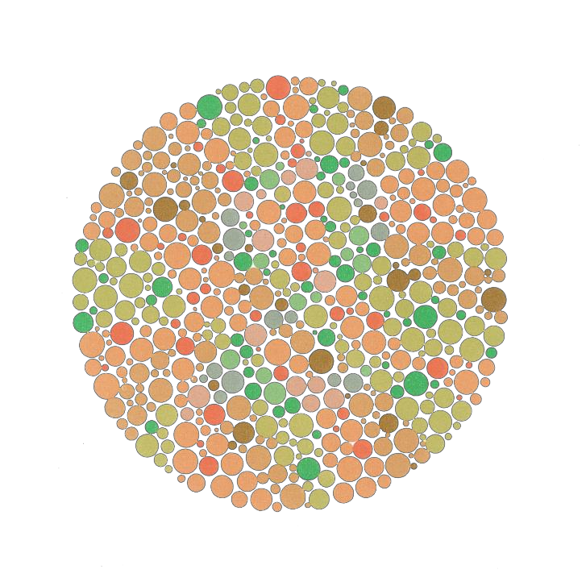
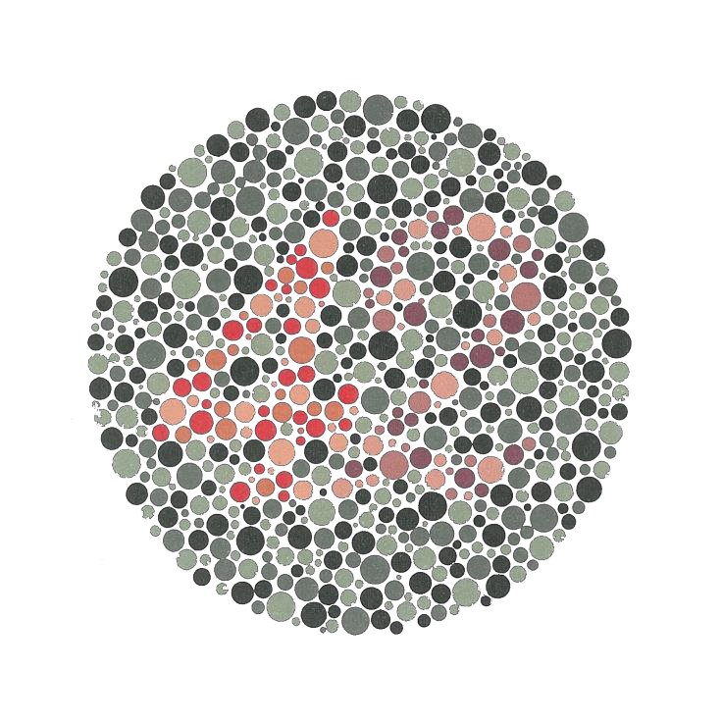
Color
and
Formatting
Color Blindness Affects 10-18% of
the Male Population
12
6
2
42
32 #mstrworld

Slide 33
Agenda
•
•
•
•
•
•
•
•
•
The Need for Data Visualization
Types and Functions of Data Visualization
The Data You Have
Getting to Know the Visualizations
Color and Formatting
Shapes and Labels
Building a Dashboard
Next Steps
Questions and
Answers
33 #mstrworld

Slide 34
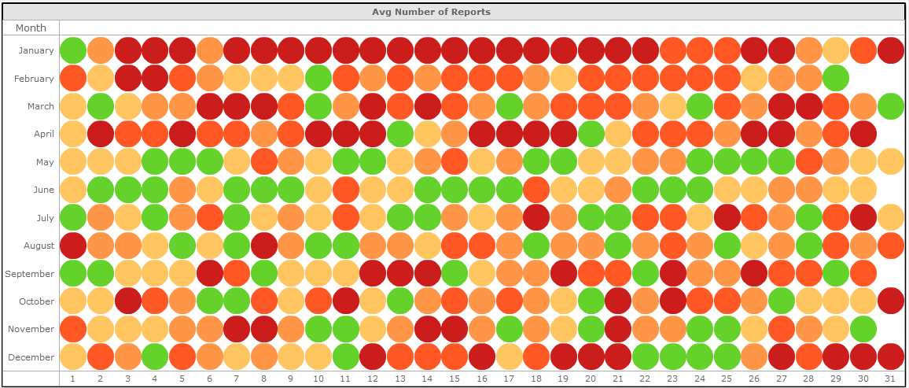



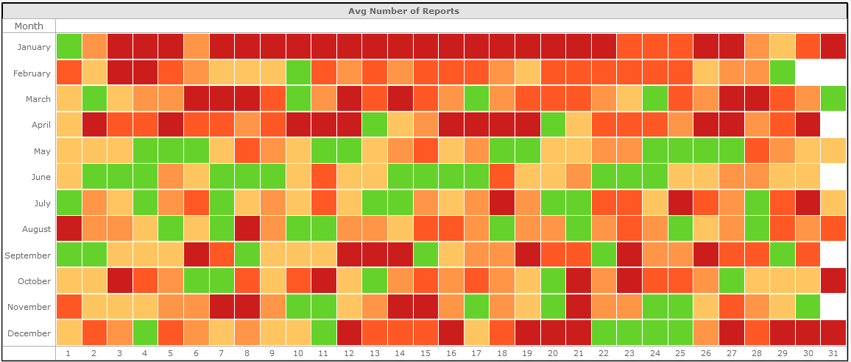
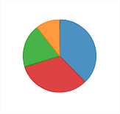

Shapes and Labels
The right shapes for your insights
Circle
Ring
Tick
Square
Bar
Pie
34 #mstrworld

Slide 35
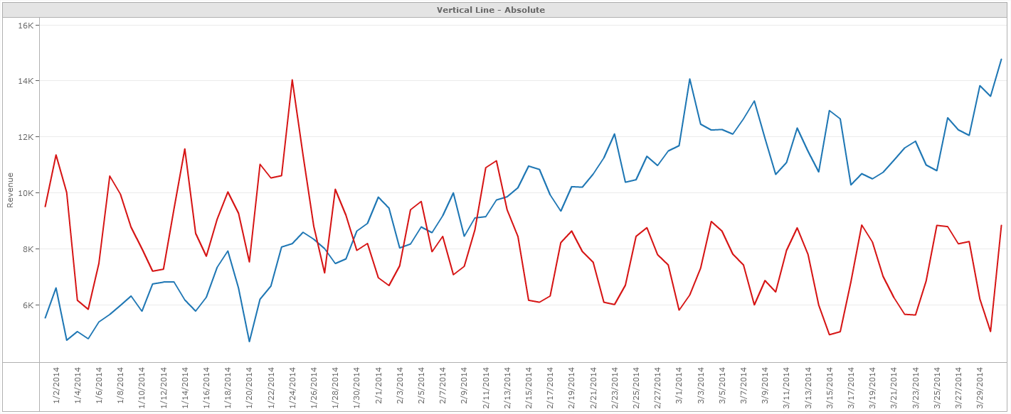
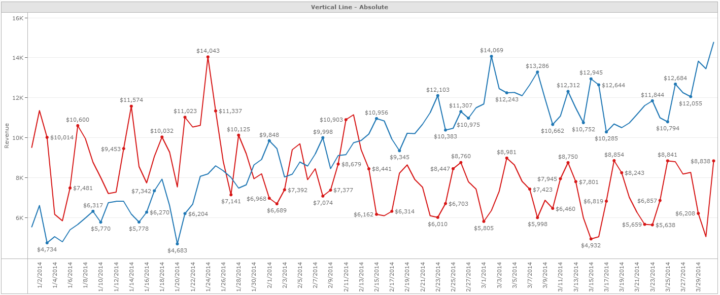
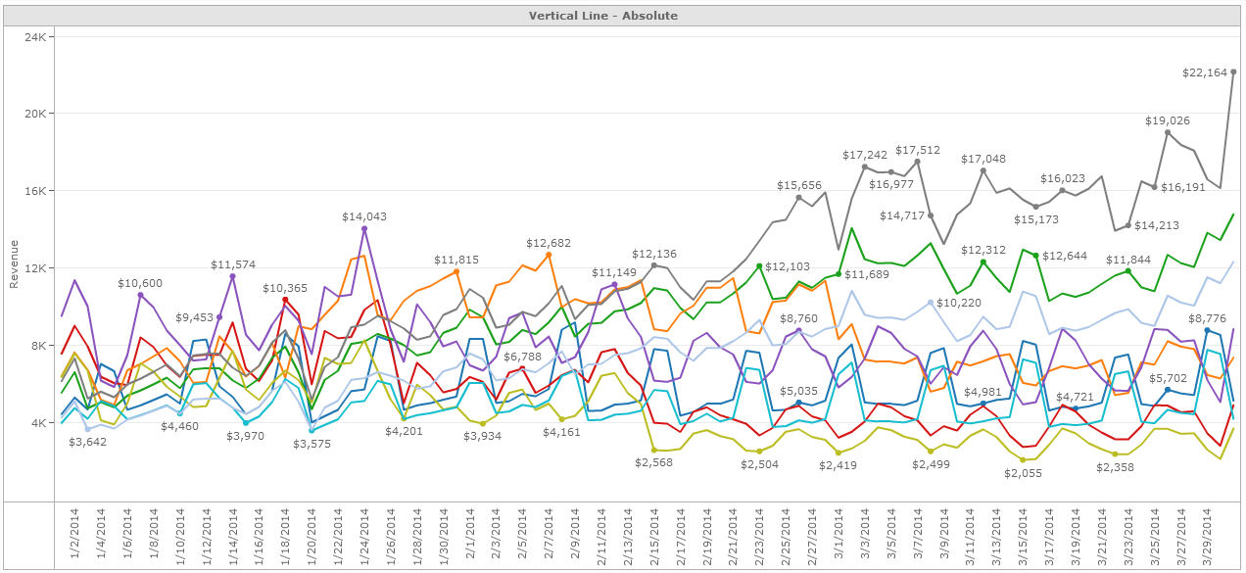
Shapes and Labels
Labels add fundamental context
Context is important - always label your axes
Label
data
points
if
more
context
is
needed
and
you
don’t
too many
35 #mstrworld

Slide 36
Agenda
•
•
•
•
•
•
•
•
•
The Need for Data Visualization
Types and Functions of Data Visualization
The Data You Have
Getting to Know the Visualizations
Color and Formatting
Shapes and Labels
Building a Dashboard
Next Steps
Questions and
Answers
36 #mstrworld

Slide 37

Building a Dashboard
Guiding the dashboard consumer
Reading Gravity
Primary
Optical Area
Strong
Fallow Area
Weak
Fallow Area
Terminal
Area
37 #mstrworld

Slide 38
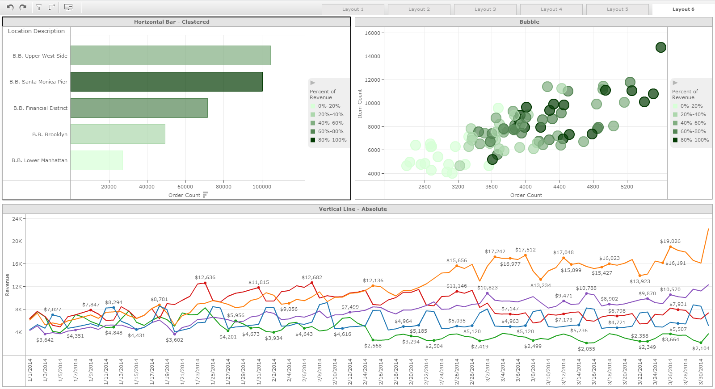

Building a Dashboard
Guiding the dashboard consumer
Reading Gravity
Primary
Optical Area
Strong
Fallow Area
Weak
Fallow Area
Terminal
Area
38 #mstrworld

Slide 39
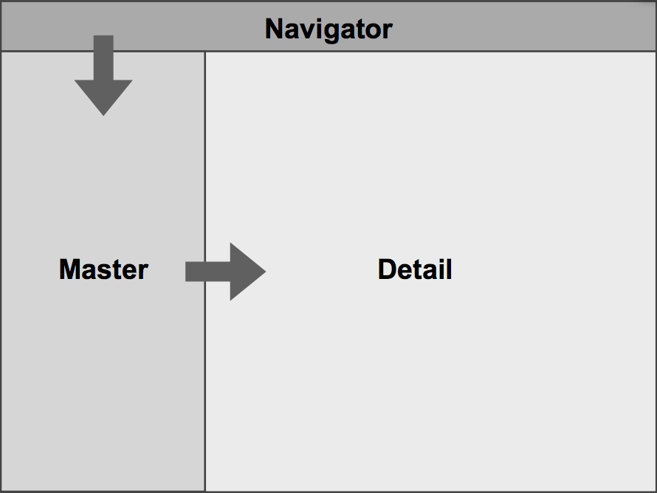
Building a Dashboard
Guiding the dashboard consumer
Present
Information Hierarchically
39 #mstrworld

Slide 40

Building a Dashboard
Guiding the dashboard consumer
Present
Information Hierarchically
40 #mstrworld

Slide 41
Agenda
•
•
•
•
•
•
•
•
•
The Need for Data Visualization
Types and Functions of Data Visualization
The Data You Have
Getting to Know the Visualizations
Color and Formatting
Shapes and Labels
Building a Dashboard
Next Steps
Questions and
Answers
41 #mstrworld

Slide 42
5
Rules
for
Successful
Data
Visualization
1. Don’t present too much information
2. Avoid using too many colors
3. Don’t distort the data
4. Organize the visualizations
5. Provide Context and Label Correctly
42 #mstrworld

